Slide 1

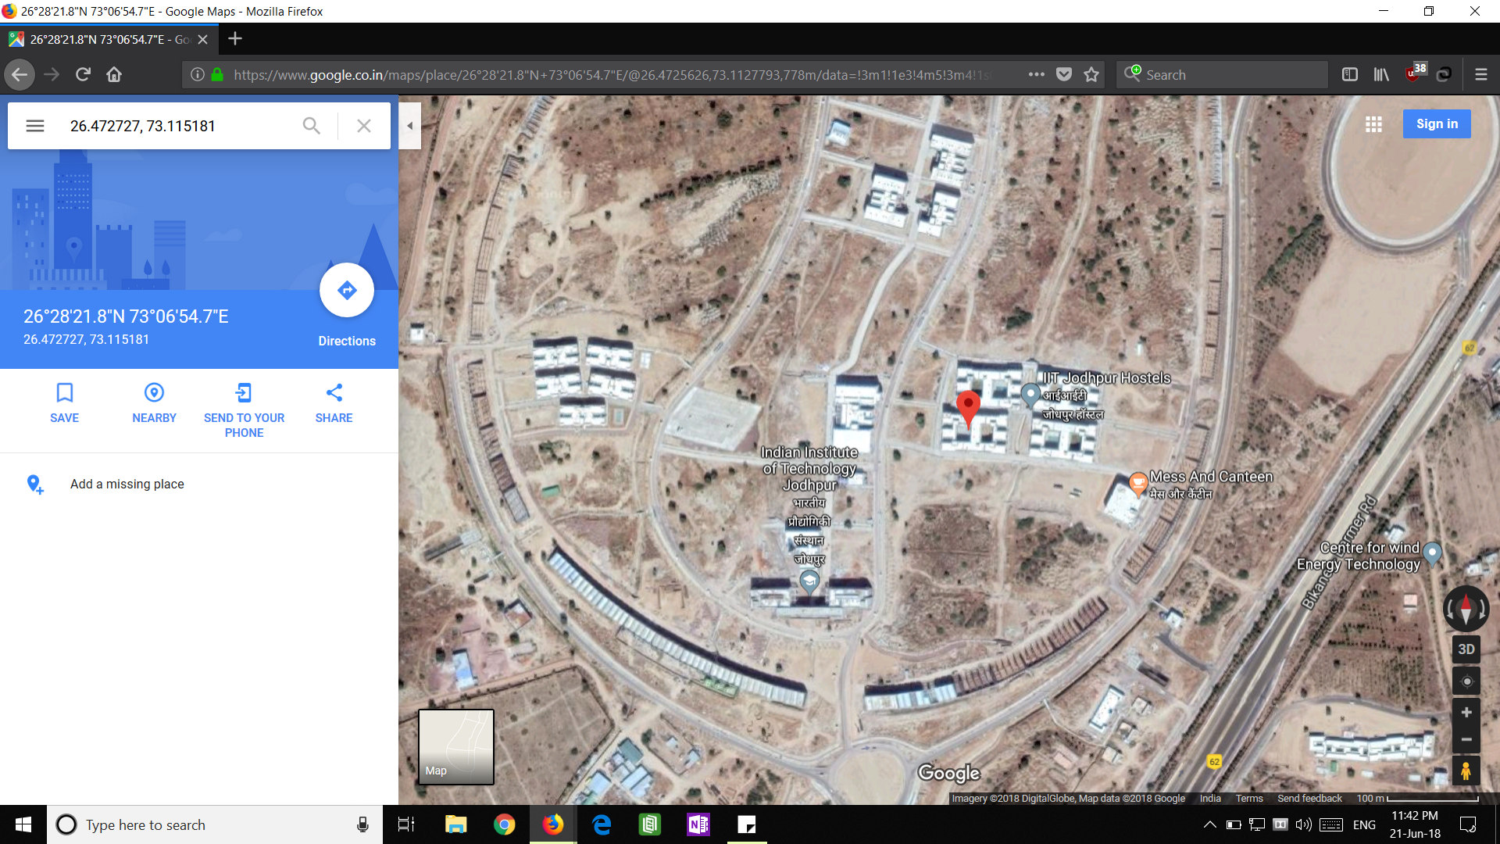
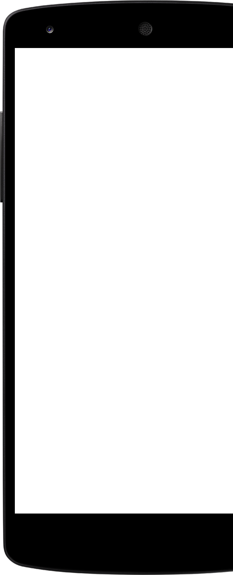

Staza
(Bosnian : Path)
Get the location of your mobile phone just by sending a code using text message

Slide 2
Problem statement
Getting location coordinates for your device without using internet
The problem statement is inspired by a real incident.
One of our friends’ mobile was lost (or rather stolen) at the famously over-crowded Dadar station. But, interestingly, the thief neither switched-off the mobile nor took the sims out for whole one week and was also using it.

Slide 3



The Team Developers | Coders | Entrepreneurs
Chinmay Garg
Ashutosh Pandey
Ashutosh Jatav
Computer Science & Engineering
IIT Jodhpur
Computer Science & Engineering
IIT Jodhpur
Electrical Engineering
IIT Jodhpur

Slide 4
Solution description
Staza keeps listening for messages in the background.
When a message is received it compares the message with the saved code.
If the message matches the saved code it forces the user to enable gps, by generating an infinite loop of requests.
After gps has been enabled, Staza retrieves the current location and replies to the sender with the location of the phone.
Money can be generated from in-app and in-message ads, and also through paid services like continuous tracking.

Slide 5
What customers do today … And why we are better
Google’s Find Your Phone
Every android user after losing their phone goes here. But this is not an ideal solution, as it demands a set of pre conditions to locate the phone.
While Staza is one step ahead as:
It does NOT depend on data usage.
Location need NOT to be turned on priorly.
It works on SMS service.
Everyone with the saved code can retrieve the location of the mobile.

Slide 6
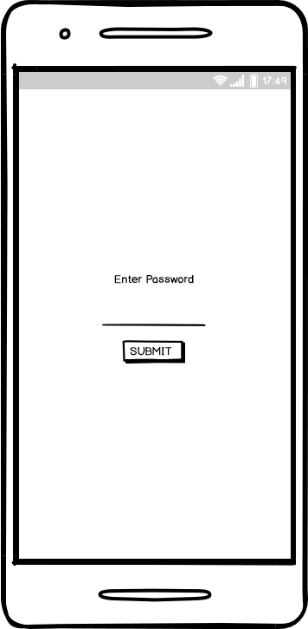
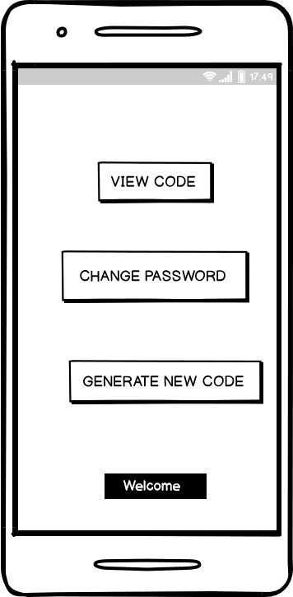
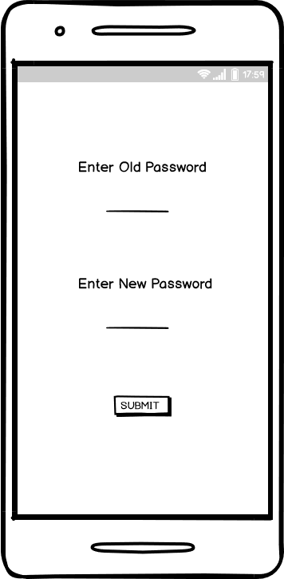
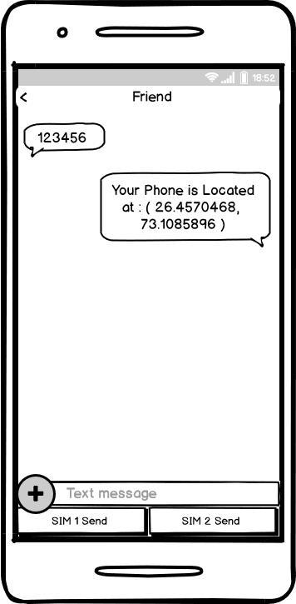
Wireframes

